Slide 1


2.4 Evaluation Criteria: Unified, Hypothesis-Driven Assessment
1. Signal-level Evaluation (German lead)
2. Structure-level
Evaluation (Korean lead)
3. Joint System-level
Validation (Integration)
Focus: Signal Fidelity & Physics-Based Encoding
Key Metrics:
-RSME & SNR Improvement
-Compression vs. Fidelity Trade-off
-Stability under Perturbations
Focus: Structural Inference & Robustness
Key Metrics:
-Geometric Accuracy (RSME)
-Scene Completeness & Coverage
-Semantic Segmentation (mIoU)
Focus: End-to-End & Casual Linkage
Key Metrics:
-Lab & Field Tests
(Controlled/Real)
-Benchmarks Comparison (Sonar/FWA)
-Causal Signal-to-Structure Translation

Slide 2
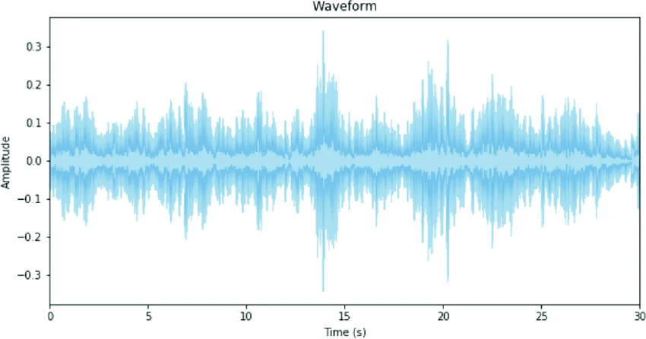

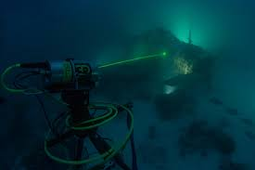
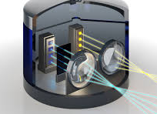




3.1 Overall Research Strategy
Complete Research Strategy & Implementation Plan
Waveform Representation
Learning
Unified Framework:
Nonlinear Underwater Optical Propagation
Structural Inverse
Inference
Research Scope & Platform
36 MONTHS JOINT IMPLEMENTATION
Fraunhofer IPM LiDAR Prototype -> Theoretical & Methodological Advancement
WP1 (Germany Lead) -> WP2 (Korea Lead) -> WP3 (Joint Lead)

Slide 3
WP1:
Fundamental Waveform Representation and
Nonlinear Propagation Modeling
A) Learning-Based
Waveform Encoding
B) Latent Space
Structure Analysis
C) Neural Architecture
Optimization
D) Propagation-Aware
Modeling
WP1 FINAL OUTCOME
Goal:
Preserve
Geometry-Sensitive Descriptors
Goal:
Analyze Evolution
under Perturbation
Goal:
Establish
Compression-Information Trade-offs
Goal:
Consistency
by Optical Scattering Theory
Preserves Structural
Signal Content
WHILE Enabling Efficient Encoding
Pulse
Asymmetry
+
Multi-peak
Interactions
+
Higher-order
moments
Varying
Turbidity &
Attenuation
+
Stability &
Robustness
Assessed
Hardware
Constraints
Minimal
Complexity
Waveform
Fidelity
Apply AI
+
Physics-Based
Interaction
(Laser-
Medium
-Object)

Slide 4
WP2:
Signal-Structure Coupling and Inverse Modeling Theory
C) Motion-Induced Distortion Modeling
WP2 FINAL OUTCOME
Spatio-temporal Alignment &
Uncertainty-aware Inference
Hydrodynamic Flow
Theoretically Grounded
Signal-structure Coupling &
Structured Inverse Modeling
A) Physics-Informed Inverse Learning
(Hybrid Loss Functions)
B) Waveform-Conditioned
Geometric Deep Learning
Surface Curvature / Inclination / Discontinuities
Loss =
Geometric Reconstruction
+ Waveform Regularization
WP1 Latent Embedding
+
Graph-based / Transformer
Point clouds
+
Multi-scale Geometric
Consistency
D) Anomaly and Degradation Detection
E) Domain Adaptation and Generalization
Erosion + Sediment + Barnacles
Controlled
Lab
transfer
Operational
Environment
Physics-consistent Anomaly Detection
learning

Slide 5
WP3:
Integrated Validation and Cross-Environment Generalization
A) Controlled Experimental Parameterization (Germany Lead)
D) End-to-End Signal-Structure
WP3 FINAL OUTCOME
Vary Turbidity & Attenuation | Vary Object Geometry | Isolate Causal Relationships
Complete Pipeline Evaluation
vs. Deterministic FWA & Sonar Benchmarks
Validated Unified Signal-Structure Framework
C) Cross-Site
Comparative Analysis
Lab Data vs. Field Data
Assess Domain Shift & Model Robustness
B) Field Validation in Hydraulic Infrastructure (Korea Lead)
Heterogeneous Turbidity | Complex Structural Geometries | Scientific Stress Tests

